Slide 1
Relocation to Berlin
IBM-Coursera
Capstone project

Slide 2
Intro
Moving to Berlin:
Berlin is a world city of culture, politics, media and science. Its economy is based on high-tech firms and the service sector, encompassing a diverse range of creative industries.
It’s simply beautiful, but how to choose the right place?

Slide 3
Problem at hand
Moving to a new country :
Factors considered:
1- Cost
2- Living quality

Slide 4
If you are going to move to Berlin, where is the best place to rent an apartment?

Slide 5
Analysing airBnB data:
We can find indicators of the rent cost ($/day).
mean: 60.9
std : 26.0
min : 25.0
max : 208.6

Slide 6
The Range is very high
max : 208.6
min : 25.0 (Lübars)
Range = 183.6

Slide 7
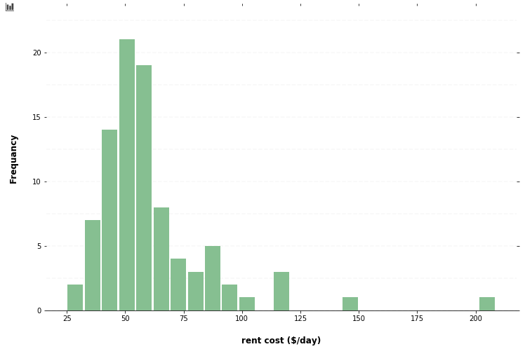
The 208.6 can be considered as an out lair.

Slide 8
Merging data of venues using Foursquare API:
To facilitate segmentation process of neighbourhoods.

Slide 9
Undergoing clustering process using Kmean method
K = 4

Slide 10
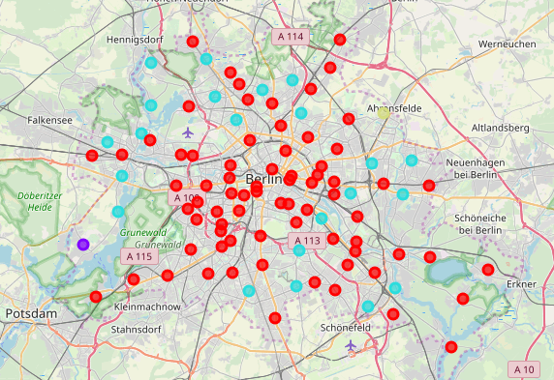

Slide 11
Cluster | Name | neighbourhoods | venues
1 | Hangout | 65 | Bars, Café, night clubs, all types of restaurants.
2 | Family | 1 | farm, zoo exhibit, home service, electronics store
3 | Shopping | 22 | supermarket, plaza, shopping stores, home store, circus
4 | foreign | 1 | gas station, farmers market, electronic store, foreign restaurants

Slide 12
Results:
The 1st cluster (Hangout cluster) is the major cluster as it contains 73% of neighbourhoods.
For me as I love hanging out, the 1st cluster is the best choice.
Luckily the least expensive neighbourhoods happen to be also in the 1st cluster. Thus, Lübars is the choice.

